Slide 1
Process Synchronization Alok Jhaldiyal Assistant Professor SoCS, UPES

Slide 2
Why needed?
Processes may need to share data
More than one process reading/writing the same data (a shared file, a database record,…)
Output of one process being used by another
Needs mechanisms to pass data between processes
Ordering executions of multiple processes may be needed to ensure correctness
Process X should not do something before process Y does something etc.
Need mechanisms to pass control signals between processes

Slide 3
Interprocess Communication (IPC)
Mechanism for processes P and Q to communicate and to synchronize their actions
Establish a communication link
Fundamental types of communication links
Shared memory
P writes into a shared location, Q reads from it and vice-versa
Message passing
P and Q exchange messages

Slide 4
Producer Consumer Problem
Entities involved:
Producers: These are processes or threads responsible for producing data items and adding them to the shared buffer.
Consumers: These are processes or threads responsible for retrieving data items from the shared buffer and processing them.
Buffer: This is a shared data structure with a limited capacity that holds the produced items until they are consumed
Constraints:
Producers must wait when the buffer is full, and they can only produce data if there is space in the buffer.
Consumers must wait when the buffer is empty, and they can only consume data if there is data available in the buffer.
Multiple producers and consumers may be running concurrently.
Key Operations: Produce & Consume

Slide 5
Producer Consumer Problem
Paradigm for cooperating processes
producer process produces information that is consumed by a consumer process.
unbounded-buffer places no practical limit on the size of the buffer.
bounded-buffer assumes that there is a fixed buffer size.
Basic synchronization requirement
Producer should not write into a full buffer
Consumer should not read from an empty buffer
All data written by the producer must be read exactly once by the consumer

Slide 6
Critical Section Problem
A "critical section" refers to a specific section of a program or code that is executed by multiple threads or processes concurrently, and where shared resources or data are accessed and manipulated.
Consider system of n processes {p₀, p₁, … p_{n-1}}
Each process has critical section segment of code
Process may be changing common variables, updating table, writing file, etc
When one process is in critical section, no other may be in its critical section
Critical section problem is to design protocol to solve this
Each process must ask permission to enter critical section in entry section, may follow critical section with exit section, then remainder section
Especially challenging with preemptive kernels

Slide 7
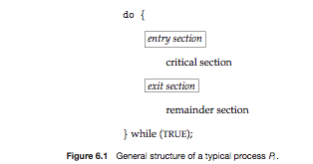
Critical Section
Entry section: a piece of code executed by a process just before entering a critical section
Exit section: a piece of code executed by a process just after leaving a critical section
General structure of a process Pi

Slide 8
Critical Section Solution
1. Mutual Exclusion - If process P_{i} is executing in its critical section, then no other processes can be executing in their critical sections
2. Progress - If no process is executing in its critical section and there exist some processes that wish to enter their critical section, then the selection of the processes that will enter the critical section next cannot be postponed indefinitely.
3. Bounded Waiting - A bound must exist on the number of times that other processes are allowed to enter their critical sections after a process has made a request to enter its critical section and before that request is granted
Assume that each process executes at a nonzero speed
No assumption concerning relative speed of the n processes

Slide 9
Mutex Locks
Simplest synchronization tool.
Mutex lock helps to protect critical regions and thus prevent race conditions.
Process must acquire the lock before entering a critical section; it releases the lock when it exits the critical section.
acquire() function acquires the lock, and the release() function releases the lock.
Mutex lock has a boolean variable available whose value indicates if the lock is available or not.

Slide 10
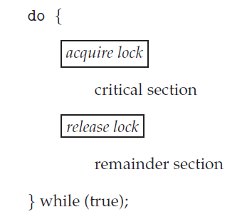
Implementation Mutex Locks
acquire()
acquire() {
while (!available)
; /* busy wait */
available = false;;
}
release()
release() {
available = true;
}

Slide 11
Busy Waiting
Main disadvantage of using mutex lock is busy waiting.
While a process is in its critical section, any other process that tries to enter its critical section must loop continuously in the call to acquire().
Continual looping is clearly a problem in a real multiprogramming system, where a single CPU is shared.
Busy waiting wastes CPU cycles that some other process might be able to use productively

Slide 12
Semaphores
Widely used synchronization tool
Does not require busy-waiting
CPU is not held unnecessarily while the process is waiting
A Semaphore S is
A data structure with an integer variable S.value and a queue S.q of processes
The data structure can only be accessed by two atomic operations, wait(S) and signal(S) (also called P(S) and V(S))
Value of the semaphore S = value of the integer S.value

Slide 13
Wait and Signal Operations
wait (S):
if (S.value > 0) S.value --;
else {
add the process to S.q;
block the process;
}
signal (S):
if (S.q is not empty)
choose a process from S.q and unblock it
else S.value ++;

Slide 14
Semaphores Types
Semaphores can be:
Counting Semaphore
Binary Semaphore
Value of binary semaphore can range only between 0 and 1, behave similarly to mutex locks.
Value of a counting semaphore can range over an unrestricted domain.
Counting semaphores can be used to control access to a given resource consisting of a finite number of instances.

Slide 15
Semaphore Usage
Each process that wishes to use a resource performs a wait() operation on the semaphore.
Also decrements the semaphore count.
When a process releases a resource, it performs a signal() operation.
Increments the count
When the count for the semaphore goes to 0, all resources are being used.
Processes that wish to use a resource will block until the count becomes greater than 0

Slide 16
Semaphore Implementation
Semaphore operations is evolved approach and have overcome the need of busy waiting.
This is implemented by modifying the basic definition of wait() and signal().
Process executes the wait() operation and finds that the semaphore value is not positive, it must wait.
Rather than engaging in busy waiting, the process can block itself.
Block operation places a process into a waiting queue associated with the semaphore

Slide 17
Semaphore Implementation
Once the process enters a semaphore waiting queue, control is transferred to the CPU scheduler.
CPU scheduler picks another process from ready queue and assigns CPU to it.
Process that is blocked, waiting on a semaphore S, should be restarted when some other process executes a signal() operation.
Process is restarted by a wakeup() operation, which changes the process from the waiting state to the ready state

Slide 18
Race Condition
A scenario in which the final output is dependent on the relative speed of the processes
Example: The final value of the shared data counter depends upon which process finishes last
Race conditions must be prevented
Concurrent processes must be synchronized
Final output should be what is specified by the program, and should not change due to relative speeds of the processes.

Slide 19
Race Condition
Suppose that two processes A and B have access to a shared variable “Balance”:
PROCESS A: PROCESS B:
Balance = Balance - 100 Balance = Balance - 200
Further, assume that Process A and Process B are executing concurrently in a time-shared, multi-programmed system.

Slide 20
Concurrent Access to Shared Data
The statement “ Balance = Balance – 100” is implemented by several machine level instructions such as:
A1. LOAD R1, BALANCE // load Balance from memory into Register 1 (R1)
A2. SUB R1, 100 // Subtract 100 from R1
A3. STORE BALANCE, R1 // Store R1’s contents back to the memory location of Balance.
Similarly, “Balance = Balance – 200” can be implemented by the following:
B1. LOAD R1, BALANCE
B2. SUB R1, 200
B3. STORE BALANCE, R1

Slide 21
Race Conditions
When multiple processes are accessing shared data without access control the final result depends on the execution order creating what we call race conditions.
A serious problem for any concurrent system using shared variables!
We need Access Control using code sections that are executed atomically.
An Atomic operation is one that completes in its entirely without context switching (i.e. without interruption).

Slide 22
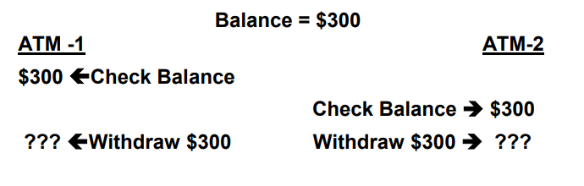

Slide 23
Readers Writers Problem
Classic problem for which design of synchronization and concurrency mechanisms can be tested.
Other Problems:
Producer/Consumer problem
Dining Philosophers Problem

Slide 24
Readers/Writers Problem Definition
There is a data area that is shared among a number of processes.
Any number of readers may simultaneously read to the data area.
Only one writer at a time may write to the data area.
If a writer is writing to the data area, no reader may read it.
If there is at least one reader reading the data area, no writer may write to it.
Readers only read and writers only write
A process that reads and writes to a data area must be considered a writer.

Slide 25
Class Work
Suggest a solution for reader/writers problem using semaphore.

